Slide 1




A Study on Cybersecurity and Information Technology Laws: Indian and Global Perspectives
Indian Laws
Global Scope
Data Privacy
Cyber Threats

Slide 2
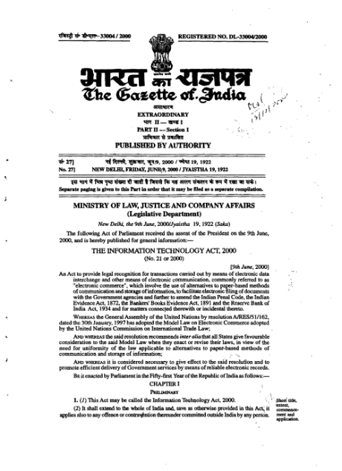

1. 🇮🇳 The Information Technology Act, 2000 (India)
The Information Technology Act, 2000 is India's primary law dealing with cybercrime and electronic commerce. It was enacted to give legal recognition to electronic records and digital signatures.
Objectives
Legal recognition of electronic transactions
Prevention and punishment of cybercrime
Facilitate e-governance
Protect data and privacy
Key Provisions
Section 43
Section 65
Section 66
Penalty for unauthorized access, data theft, introducing viruses, and damaging systems.
Tampering with computer source documents.
Computer-related offenses (hacking, fraud).
Section 66C
Section 66D
Section 66E
Identity theft (misuse of digital signatures, passwords).
Cheating by personation using computer resources (online scams).
Violation of privacy (capturing/transmitting private images).
Section 66F
Section 70
Cyber terrorism.
Protected systems (critical infrastructure protection).
Section 67
Section 72
Publishing or transmitting obscene material electronically.
Breach of confidentiality and privacy.
Section 69
Government power to intercept, monitor, or decrypt information.
2008 Amendment
The IT Act was significantly amended in 2008:
Introduced data protection concepts
Added cyber terrorism
Recognized electronic signatures
Strengthened penalties

Slide 3
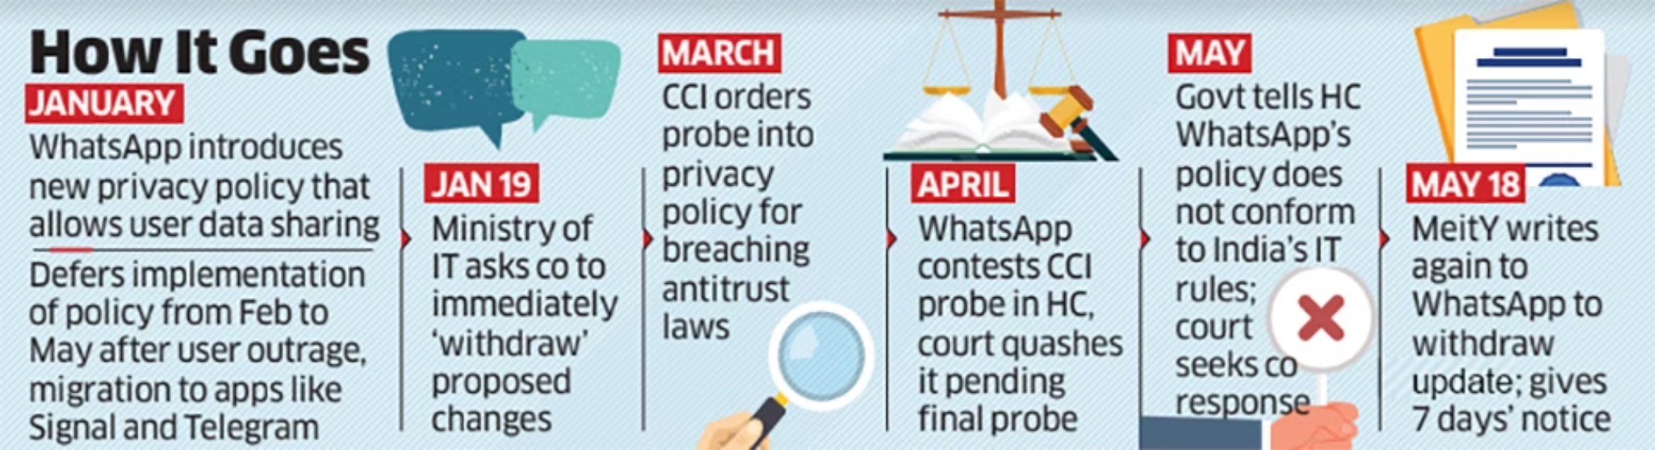








2. 🇮🇳 Digital Personal Data Protection Act, 2023 (India)
The Digital Personal Data Protection Act, 2023 regulates processing of digital personal data.
Key Features
Consent-based data processing
Rights of individuals (data principals)
Data fiduciary responsibilities
Penalties up to ₹250 crore
Establishment of Data Protection Board of India
Individual Rights
Right to access data
Right to correction and erasure
Right to grievance redressal

Slide 4

GLOBAL CYBERSECURITY LAWS

Slide 5
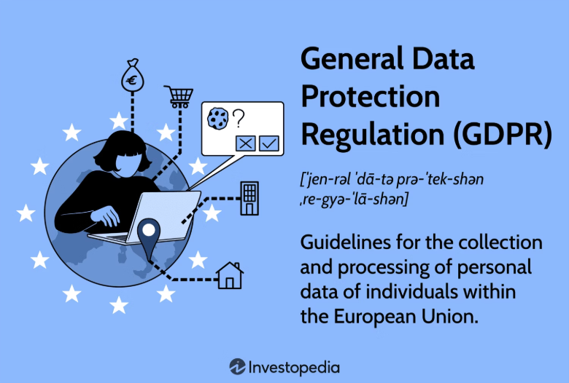




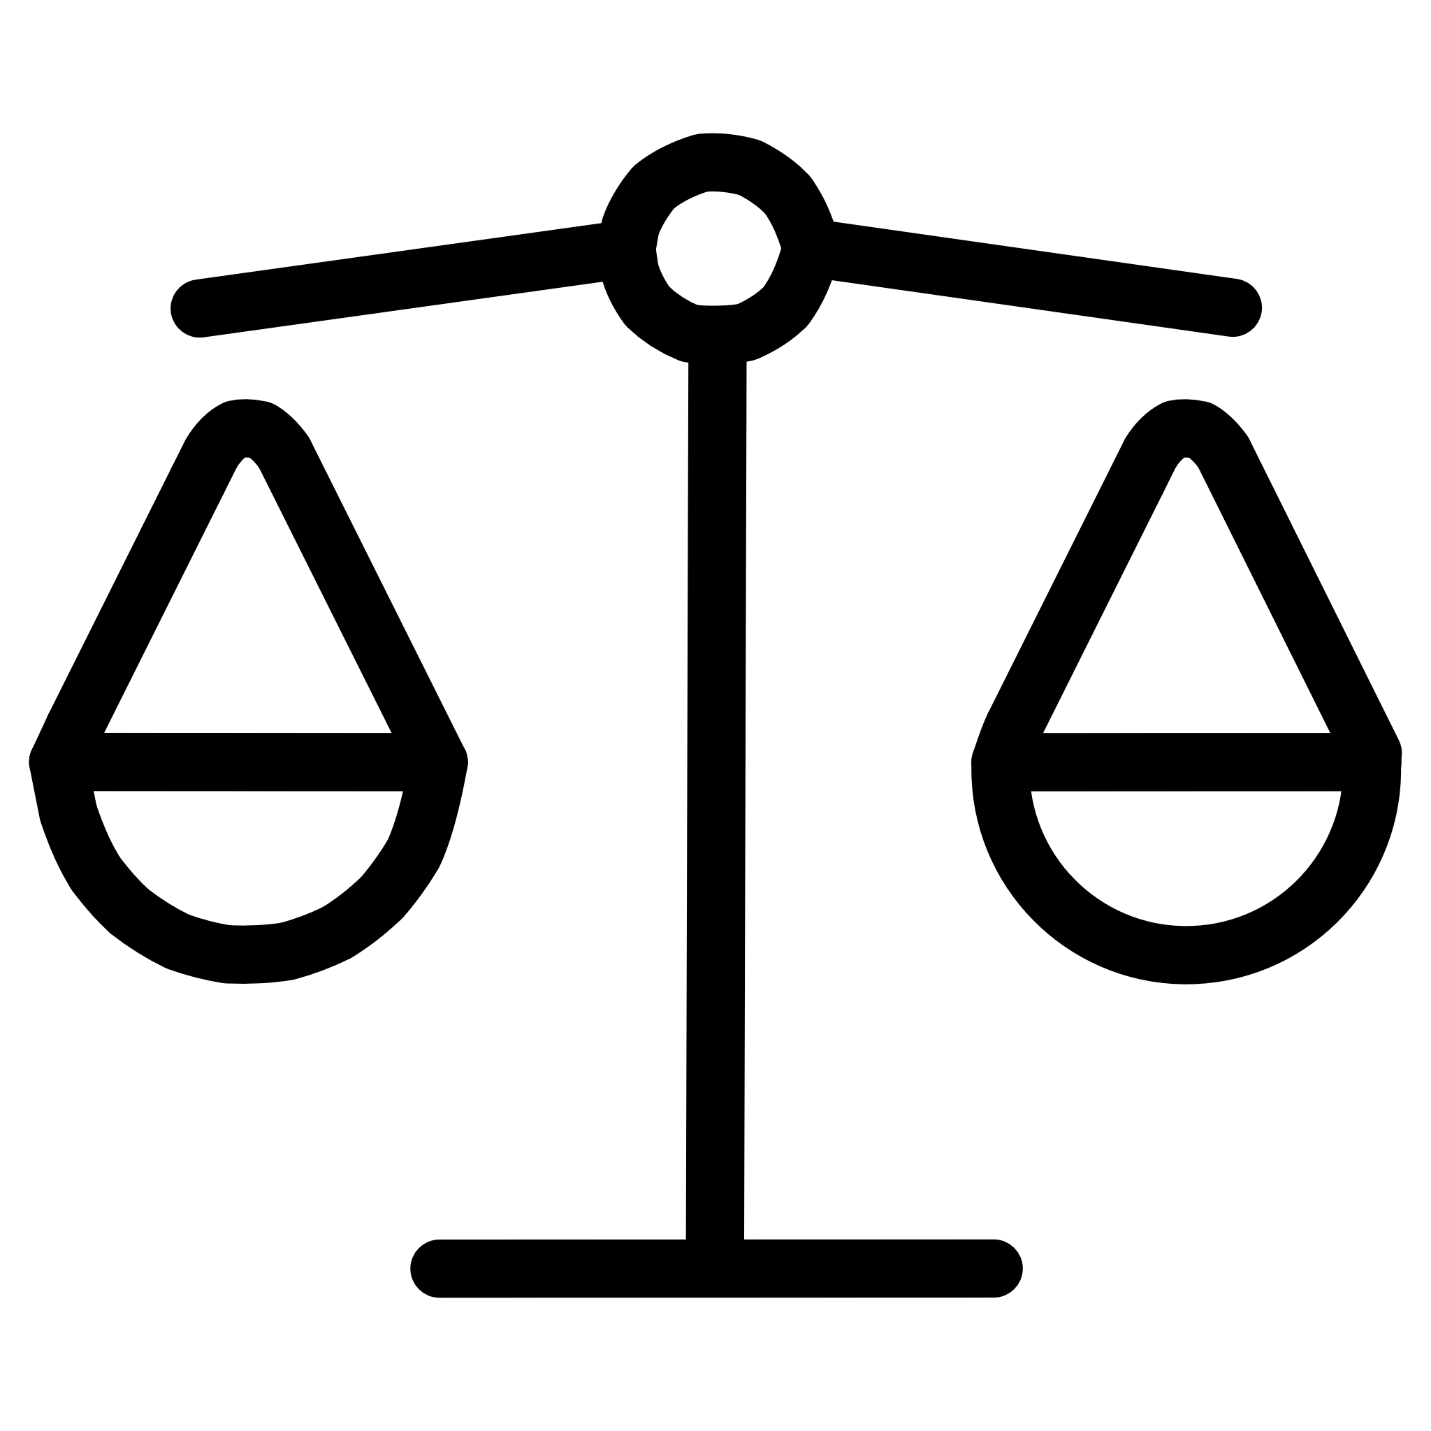









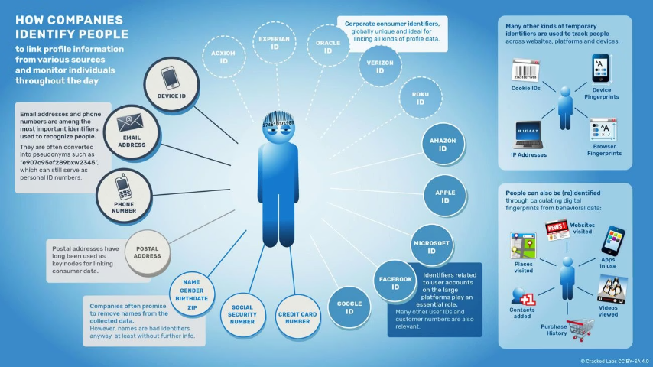
3. 🇪🇺 General Data Protection Regulation (GDPR)
The General Data Protection Regulation is the European Union's data protection law (effective 2018).
Key Principles
Lawfulness, fairness, transparency
Purpose limitation
Data minimization
Accuracy
Storage limitation
Integrity & confidentiality
Accountability
Penalties
Up to €20 million or 4% of global annual turnover (whichever is higher).

Slide 6

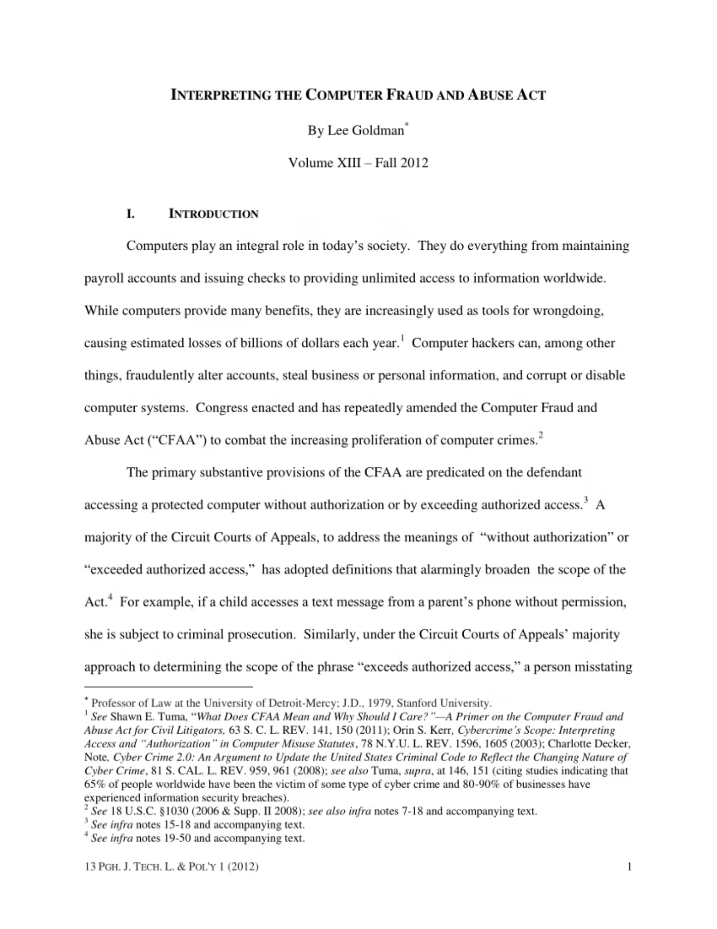
4. 🇺🇸 Computer Fraud and Abuse Act (CFAA)
The Computer Fraud and Abuse Act is the primary anti-hacking law in the United States.
Covers
Unauthorized access to computers
Fraud via computers
Damage to protected systems
Trafficking in passwords

Slide 7
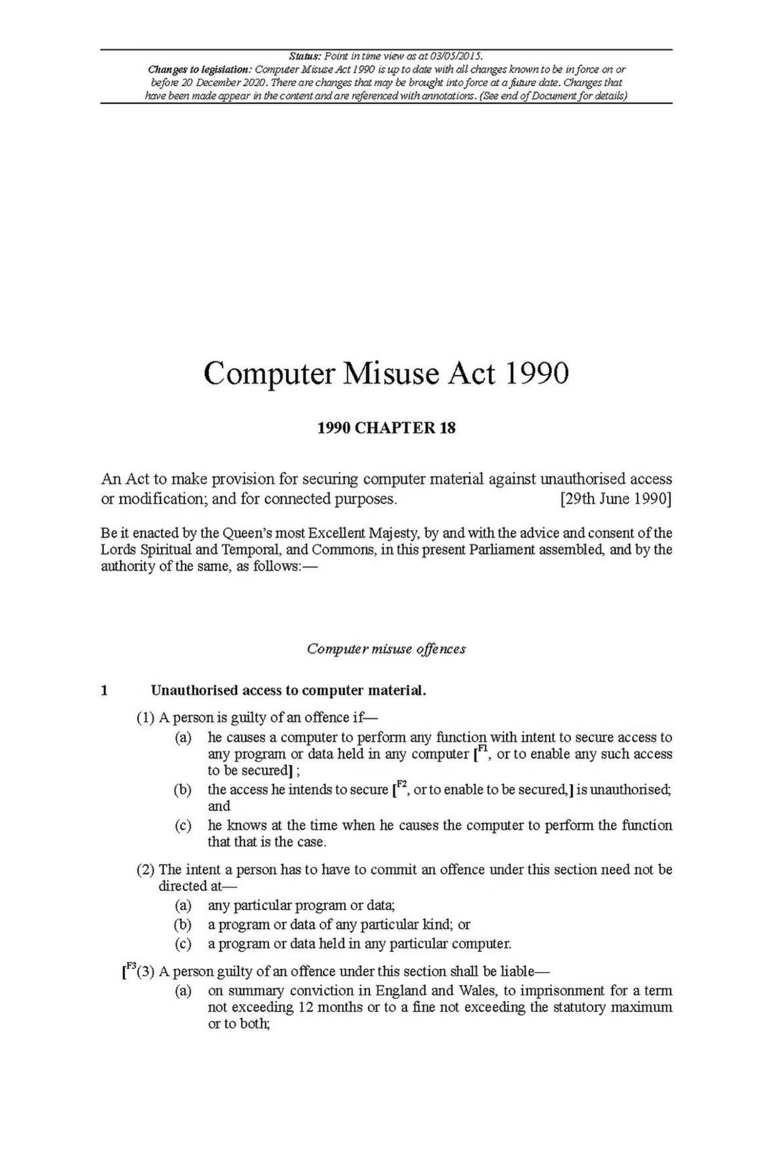
5. 🇬🇧 UK Computer Misuse Act, 1990
The Computer Misuse Act 1990 criminalizes unauthorized access to computer systems.
Offenses
Unauthorized access
1
Access with intent to commit further offenses
2
Unauthorized modification of data
3

Slide 8

6. 🇦🇺 Australian Cybercrime Act, 2001
The Cybercrime Act 2001 addresses hacking, online fraud, and cyber terrorism.

Slide 9
OTHER IMPORTANT INDIAN CYBER-RELATED LAWS
1
1. Indian Penal Code (IPC), 1860
Applied in cyber fraud, cheating, identity theft.
2
2. Companies Act, 2013
Mandates cybersecurity and data protection for companies.
3
3. CERT-In Rules (2022)
Mandatory cyber incident reporting within 6 hours.

Slide 10









TYPES OF CYBER CRIMES COVERED UNDER THESE ACTS
Hacking
Identity theft
Phishing
Cyber terrorism
Online fraud
Data breaches
Ransomware attacks
Publishing obscene content
Denial of Service (DoS) attacks

Slide 11
COMPARISON TABLE
Law
Country Focus
Max Penalty
IT Act 2000
India
Cybercrime + E-commerce
Life imprisonment (terrorism cases)
DPDP Act 2023
India
Data Protection
₹250 Crore
GDPR
EU
Data Protection
€20M / 4% turnover
CFAA
USA
Hacking
Up to 20 years
Computer Misuse Act
UK
Unauthorized access
10+ years

Slide 12
Cybersecurity laws aim to:
Protect digital infrastructure
Safeguard personal data
Prevent cybercrime
Regulate online transactions
Ensure accountability of organizations
India's IT Act forms the backbone of cyber law, while global frameworks like GDPR set strong standards for privacy and compliance.

